Slide 1

Chapter 1 Introduction
Computer Networking: A Top Down Approach 6th edition Jim Kurose, Keith Ross Addison-Wesley March 2012
CS3516:
These slides are generated from those made available by the authors of our text.

Slide 2
Lecture 1: roadmap
our goal:
get “feel” and terminology
more depth, detail later in course
1.1 what is the Internet?
1.2 network edge
end systems, access networks, links
1.7 history

Slide 3




















What’s the Internet: “nuts and bolts” view
PC
millions of connected computing devices:
hosts = end systems
running network apps
mobile network
server
wireless
laptop
global ISP
smartphone
home
network
communication links
fiber, copper, radio, satellite
transmission rate: bandwidth
regional ISP
wireless
links
wired
links
Packet switches: forward packets (chunks of data)
routers and switches
router
institutional
network
Notes:
3

Slide 4

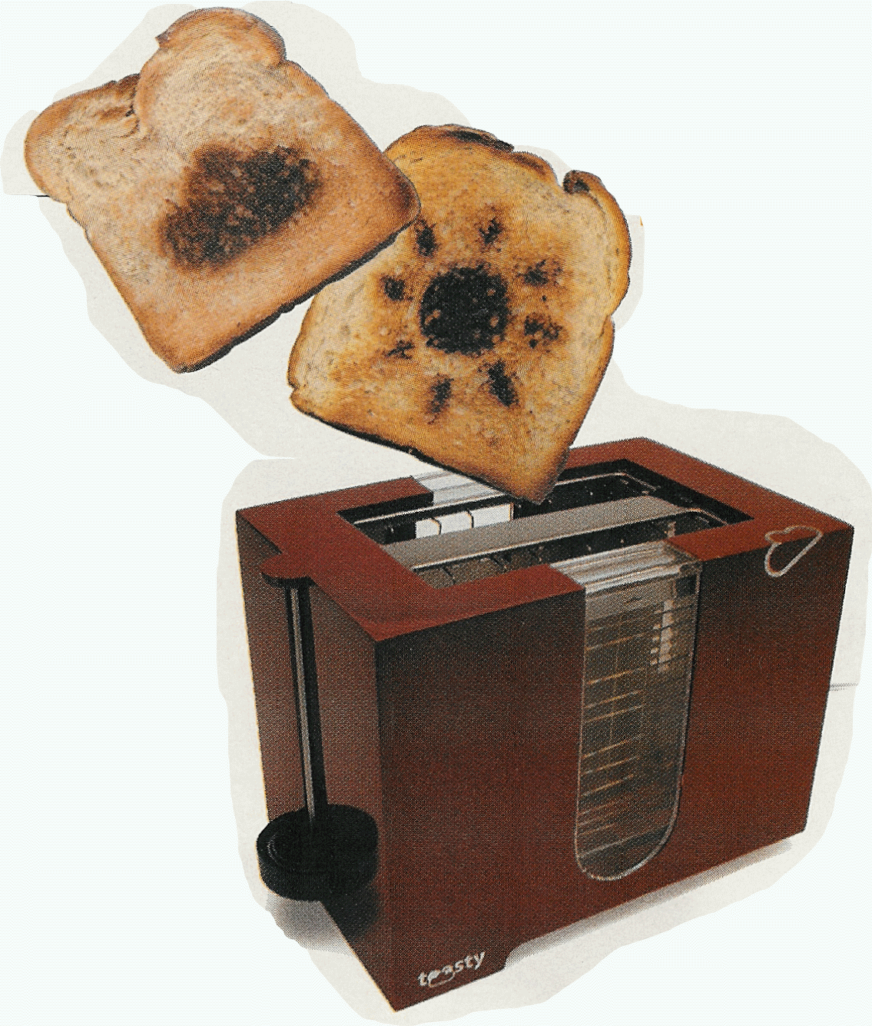
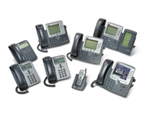

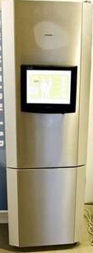
“Fun” internet appliances
Web-enabled toaster +
weather forecaster
IP picture frame
http://www.ceiva.com/
Tweet-a-watt:
monitor energy use
Slingbox: watch,
control cable TV remotely
Internet
refrigerator
Internet phones

Slide 5
What’s the Internet: “nuts and bolts” view
Internet: “network of networks”
Interconnected ISPs
protocols control sending, receiving of msgs
e.g., TCP, IP, HTTP, Skype, 802.11
Internet standards
RFC: Request for comments
IETF: Internet Engineering Task Force
mobile network
global ISP
home
network
regional ISP
institutional
network

Slide 6
What’s the Internet: a service view
mobile network
Infrastructure that provides services to applications:
Web, VoIP, email, games, e-commerce, social nets, …
provides programming interface to apps
hooks that allow sending and receiving app programs to “connect” to Internet
provides service options, analogous to postal service
global ISP
home
network
regional ISP
institutional
network

Slide 7
What’s a protocol?
human protocols:
“what’s the time?”
“I have a question”
introductions
… specific msgs sent
… specific actions taken when msgs received, or other events
network protocols:
machines rather than humans
all communication activity in Internet governed by protocols
protocols define format, order of msgs sent and received among network entities, and actions taken on msg transmission, receipt

Slide 8



What’s a protocol?
a human protocol and a computer network protocol:
Hi
TCP connection
request
Hi
TCP connection
response
Got the
time?
Get http://www.awl.com/kurose-ross
2:00
<file>
time
Q: other human protocols?

Slide 9
Lecture 1: roadmap
1.1 what is the Internet?
1.2 network edge
end systems, access networks, links
1.7 history
Notes:
9

Slide 10

A closer look at network structure:
network edge:
hosts: clients and servers
servers often in data centers
mobile network
global ISP
access networks, physical media: wired, wireless communication links
home
network
regional ISP
network core:
interconnected routers
network of networks
institutional
network

Slide 11


Access networks and physical media
Q: How to connect end systems to edge router?
residential access nets
institutional access networks (school, company)
mobile access networks
keep in mind:
bandwidth (bits per second) of access network?
shared or dedicated?

Slide 12
Access net: digital subscriber line (DSL)
central office
telephone
network
DSL
modem
splitter
DSLAM
ISP
voice, data transmitted
at different frequencies over
dedicated line to central office
DSL access
multiplexer
use existing telephone line to central office DSLAM
data over DSL phone line goes to Internet
voice over DSL phone line goes to telephone net
< 2.5 Mbps upstream transmission rate (typically < 1 Mbps)
< 24 Mbps downstream transmission rate (typically < 10 Mbps)

Slide 13
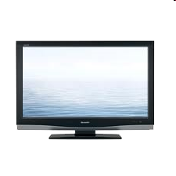


Access net: cable network
cable headend
…
cable
modem
splitter
C
O
N
T
R
O
L
V
I
D
E
O
V
I
D
E
O
V
I
D
E
O
V
I
D
E
O
V
I
D
E
O
V
I
D
E
O
D
A
T
A
D
A
T
A
1
2
3
4
5
6
7
8
9
Channels
frequency division multiplexing: different channels transmitted
in different frequency bands

Slide 14
Access net: cable network
cable headend
…
cable
modem
splitter
CMTS
cable modem
termination system
data, TV transmitted at different
frequencies over shared cable
distribution network
ISP
HFC: hybrid fiber coax
asymmetric: up to 30Mbps downstream transmission rate, 2 Mbps upstream transmission rate
network of cable, fiber attaches homes to ISP router
homes share access network to cable headend
unlike DSL, which has dedicated access to central office

Slide 15





Access net: home network
wireless
devices
to/from headend or central office
often combined
in single box
cable or DSL modem
wireless access
point (54 Mbps)
router, firewall, NAT
wired Ethernet (100 Mbps)

Slide 16









Enterprise access networks (Ethernet)
institutional link to
ISP (Internet)
institutional router
Ethernet
switch
institutional mail,
web servers
typically used in companies, universities, etc
10 Mbps, 100Mbps, 1Gbps, 10Gbps transmission rates
today, end systems typically connect into Ethernet switch

Slide 17








Wireless access networks
shared wireless access network connects end system to router
via base station aka “access point”
wide-area wireless access
provided by telco (cellular) operator, 10’s km
between 1 and 10 Mbps
3G, 4G: LTE
wireless LANs:
within building (100 ft)
802.11b/g (WiFi): 11, 54 Mbps transmission rate
to Internet
to Internet

Slide 18
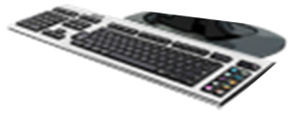
Host: sends packets of data
host sending function:
takes application message
breaks into smaller chunks, known as packets, of length L bits
transmits packet into access network at transmission rate R
link transmission rate, aka link capacity, aka link bandwidth
two packets,
L bits each
2
1
R: link transmission rate
host
packet
transmission
delay
time needed to
transmit L-bit
packet into link
L (bits)
R (bits/sec)
=
=

Slide 19
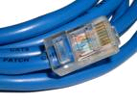
Physical media
bit: propagates between transmitter/receiver pairs
physical link: what lies between transmitter & receiver
guided media:
signals propagate in solid media: copper, fiber, coax
unguided media:
signals propagate freely, e.g., radio
twisted pair (TP)
two insulated copper wires
Category 5: 100 Mbps, 1 Gpbs Ethernet
Category 6: 10Gbps

Slide 20


Physical media: coax, fiber
coaxial cable:
two concentric copper conductors
bidirectional
broadband:
multiple channels on cable
HFC
fiber optic cable:
glass fiber carrying light pulses, each pulse a bit
high-speed operation:
high-speed point-to-point transmission (e.g., 10’s-100’s Gpbs transmission rate)
low error rate:
repeaters spaced far apart
immune to electromagnetic noise

Slide 21
Physical media: radio
signal carried in electromagnetic spectrum
no physical “wire”
bidirectional
propagation environment effects:
reflection
obstruction by objects
interference
radio link types:
terrestrial microwave
e.g. up to 45 Mbps channels
LAN (e.g., WiFi)
11Mbps, 54 Mbps
wide-area (e.g., cellular)
3G cellular: ~ few Mbps
satellite
Kbps to 45Mbps channel (or multiple smaller channels)
270 msec end-end delay
geosynchronous versus low altitude

Slide 22
Lecture 1: roadmap
1.1 what is the Internet?
1.2 network edge
end systems, access networks, links
1.7 history
Notes:
22

Slide 23
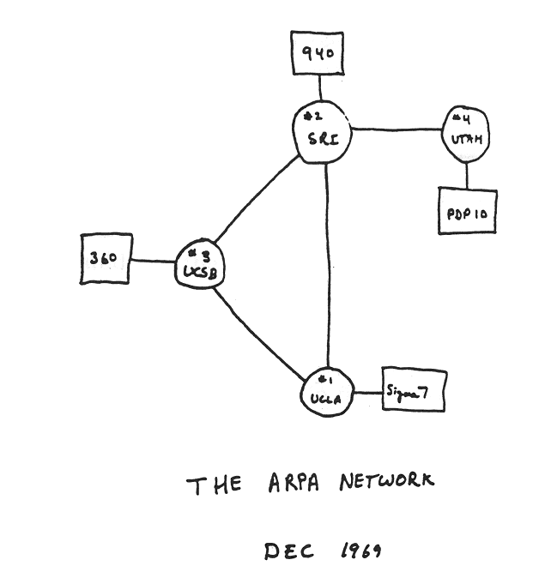
Internet history
1961-1972: Early packet-switching principles
1961: Kleinrock - queueing theory shows effectiveness of packet-switching
1964: Baran - packet-switching in military nets
1967: ARPAnet conceived by Advanced Research Projects Agency
1969: first ARPAnet node operational
1972:
ARPAnet public demo
NCP (Network Control Protocol) first host-host protocol
first e-mail program
ARPAnet has 15 nodes

Slide 24
Internet history
1972-1980: Internetworking, new and proprietary nets
1970: ALOHAnet satellite network in Hawaii
1974: Cerf and Kahn - architecture for interconnecting networks
1976: Ethernet at Xerox PARC
late70’s: proprietary architectures: DECnet, SNA, XNA
late 70’s: switching fixed length packets (ATM precursor)
1979: ARPAnet has 200 nodes
Cerf and Kahn’s internetworking principles:
minimalism, autonomy - no internal changes required to interconnect networks
best effort service model
stateless routers
decentralized control
define today’s Internet architecture

Slide 25
Internet history
1980-1990: new protocols, a proliferation of networks
1983: deployment of TCP/IP
1982: smtp e-mail protocol defined
1983: DNS defined for name-to-IP-address translation
1985: ftp protocol defined
1988: TCP congestion control
new national networks: Csnet, BITnet, NSFnet, Minitel
100,000 hosts connected to confederation of networks

Slide 26
Internet history
1990, 2000’s: commercialization, the Web, new apps
early 1990’s: ARPAnet decommissioned
1991: NSF lifts restrictions on commercial use of NSFnet (decommissioned, 1995)
early 1990s: Web
hypertext [Bush 1945, Nelson 1960’s]
HTML, HTTP: Berners-Lee
1994: Mosaic, later Netscape
late 1990’s: commercialization of the Web
late 1990’s – 2000’s:
more killer apps: instant messaging, P2P file sharing
network security to forefront
est. 50 million host, 100 million+ users
backbone links running at Gbps

Slide 27
Internet history
2005-present
~750 million hosts
Smartphones and tablets
Aggressive deployment of broadband access
Increasing ubiquity of high-speed wireless access
Emergence of online social networks:
Facebook: soon one billion users
Service providers (Google, Microsoft) create their own networks
Bypass Internet, providing “instantaneous” access to search, emai, etc.
E-commerce, universities, enterprises running their services in “cloud” (eg, Amazon EC2)

